Slide 1

Introduction to Time series
Felipe buchbinder

Slide 2

= a detour = Time series is not part of panel data. However, since we’ll use this in our next lecture, and since you won’t cover it in any other course in your curriculum (as far as I know), I’ll talk about it now, just to make sure you won’t graduate without ever having covered this topic. Therefore, let’s make a detour to talk about time series. We’ll get back to panel data in our next lecture.

Slide 3
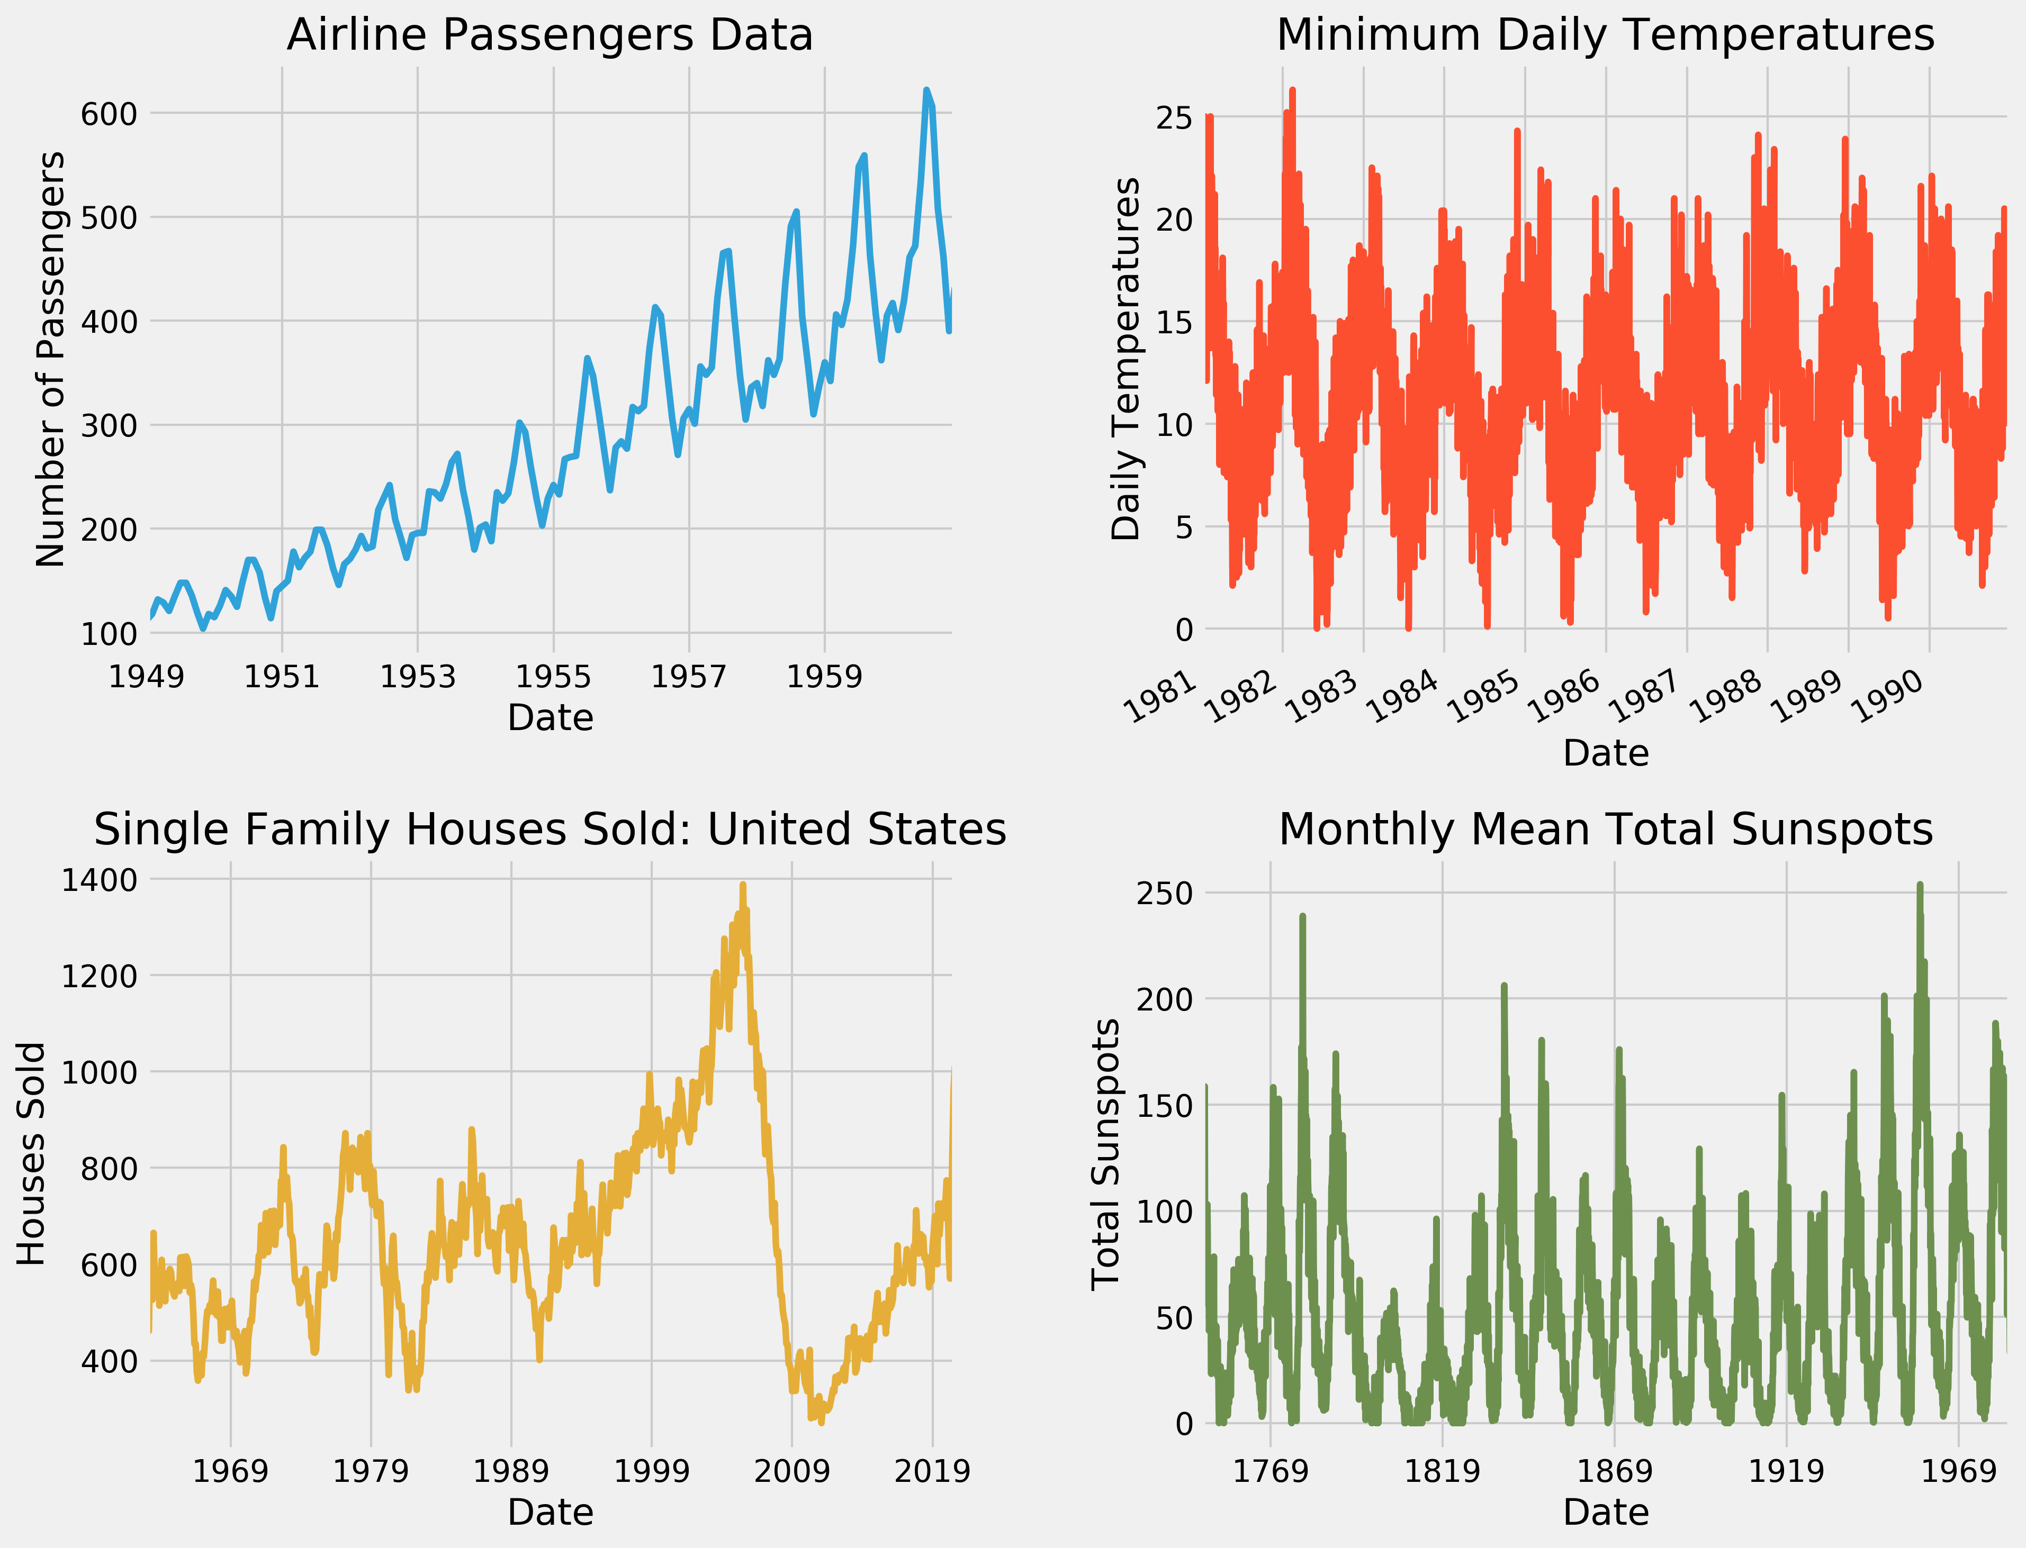
A Time series is data on how something changes over time

Slide 4
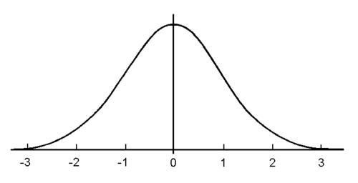
We can think of a time series as the sequence of values that we get from drawing from a probability distribution once at each time period
$$y_{1},y_{2},y_{3},y_{4},…,y_{t−1},y_{t},y_{t+1},…$$

Slide 5
Stationarity (strong)
A time series is said to be strongly stationary if the probability distribution that produces it doesn’t change over time

Slide 6
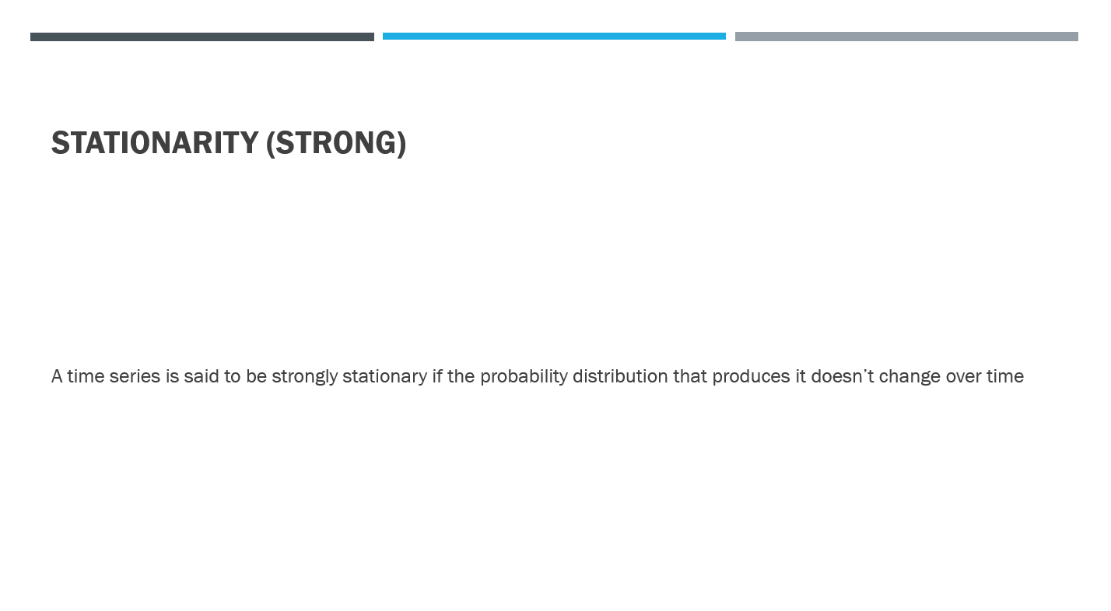
Strong stationarity is very hard do prove (why?)

Slide 7
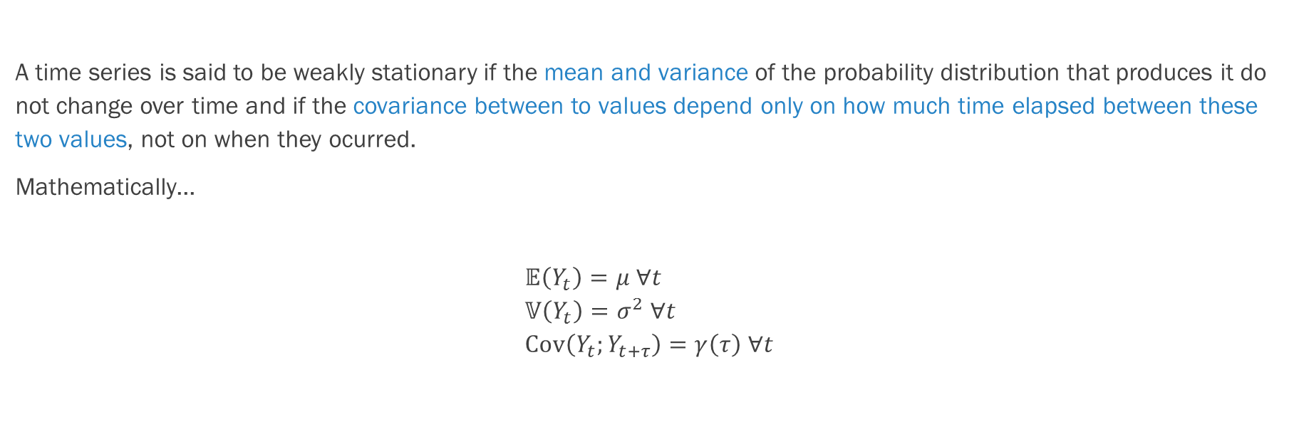
Stationarity (weak)
A time series is said to be weakly stationary if the mean and variance of the probability distribution that produces it do not change over time and if the covariance between to values depend only on how much time elapsed between these two values, not on when they ocurred.
Mathematically...
$$𝔼\left(Y_{t}\right)=μ ∀t \\ 𝕍\left(Y_{t}\right)=σ^{2} ∀t \\ Cov\left(Y_{t};Y_{t+τ}\right)=γ\left(τ\right) ∀t$$

Slide 8
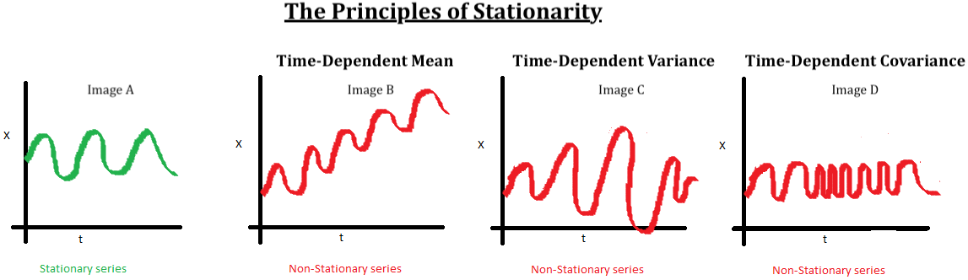

Slide 9
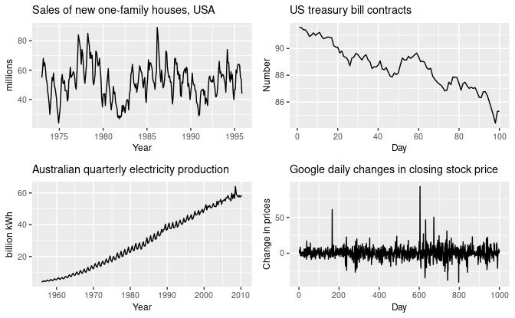
Real-world examples

Slide 10
Components of a time series
Time Series = Trend + Seasonality + Cycle + Noise

Slide 11
Components of a time series
Time Series = Trend + Seasonality + Cycle + Noise
Tackle with regression

Slide 12
Components of a time series
Time Series = Trend + Seasonality + Cycle + Noise
add dummy variables to the regression

Slide 13
Components of a time series
Time Series = Trend + Seasonality + Cycle + Noise
New stuff!
This is what we’ll talk about today

Slide 14
Classical time series models
Autoregressive models – AR(p)
Moving Average models – MA(q)
Autoregressive Moving Average models – ARMA(p,q)
Autoregressive Integrated Moving Average models – ARIMA(p,d,q)
Conditionally Heteroskedastic Models – ARCH, GARCH and variations
Vector Autoregressive Models

Slide 15
Classical time series models
Autoregressive models – AR(p)
Moving Average models – MA(q)
Autoregressive Moving Average models – ARMA(p,q)
Autoregressive Integrated Moving Average models – ARIMA(p,d,q)
Conditionally Heteroskedastic Models – ARCH, GARCH and variations
Vector Autoregressive Models

Slide 16
Autoregressive models
When yesterday still matters today

Slide 17
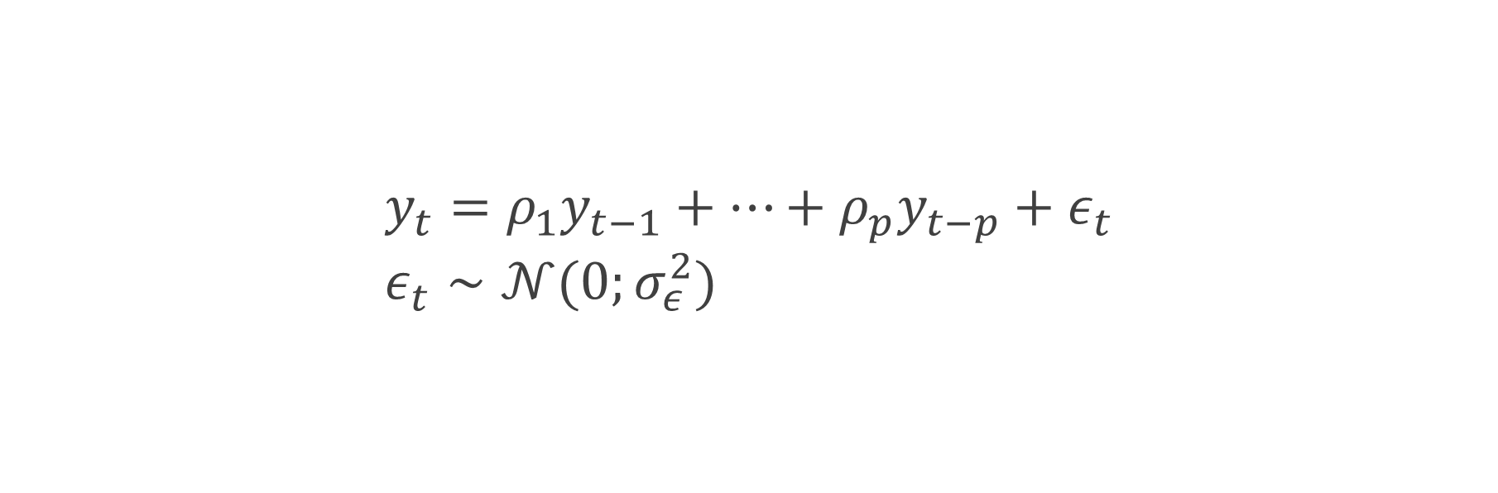
AR(p) When the p previous days still matter today
$$y_{t}=ρ_{1}y_{t−1}+…+ρ_{p}y_{t−p}+ε_{t} \\ ε_{t}∼𝒩(0;σ_{ε}^{2})$$

Slide 18
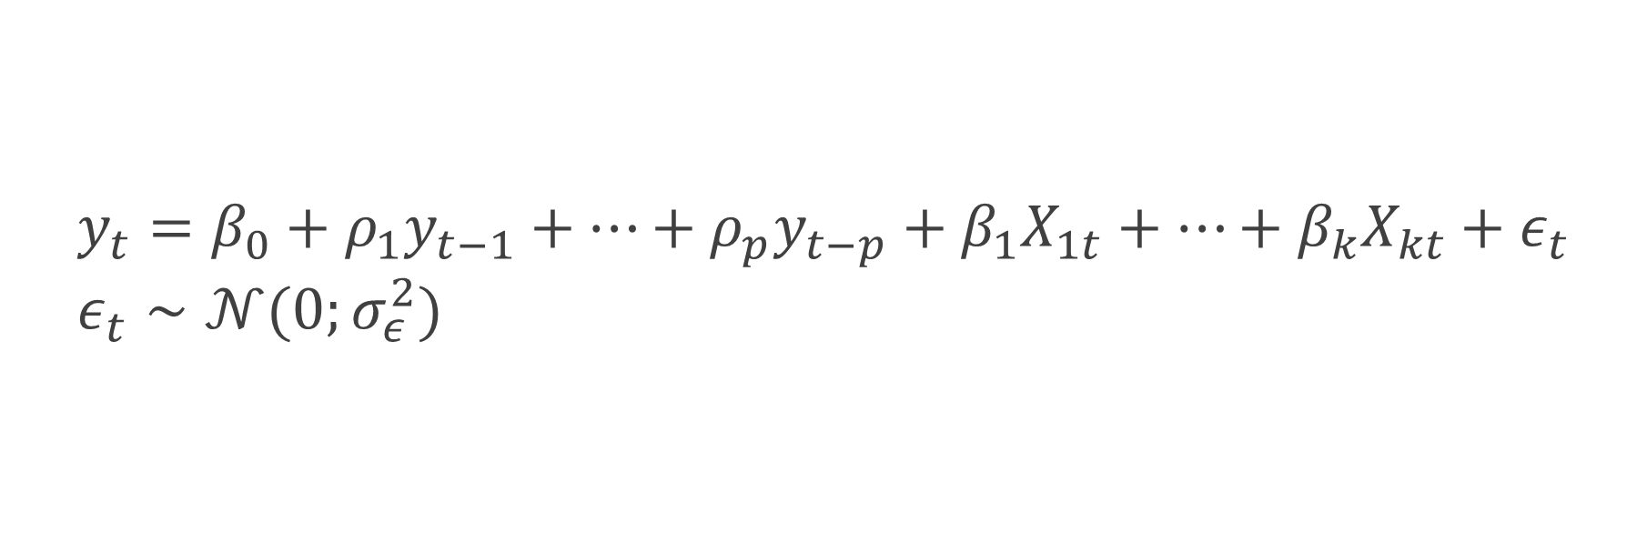
AR(p) with covariates When the p previous days still matter today
$$y_{t}=β_{0}+ρ_{1}y_{t−1}+…+ρ_{p}y_{t−p}+β_{1}X_{1t}+…+β_{k}X_{kt}+ε_{t} \\ ε_{t}∼𝒩(0;σ_{ε}^{2})$$

Slide 19
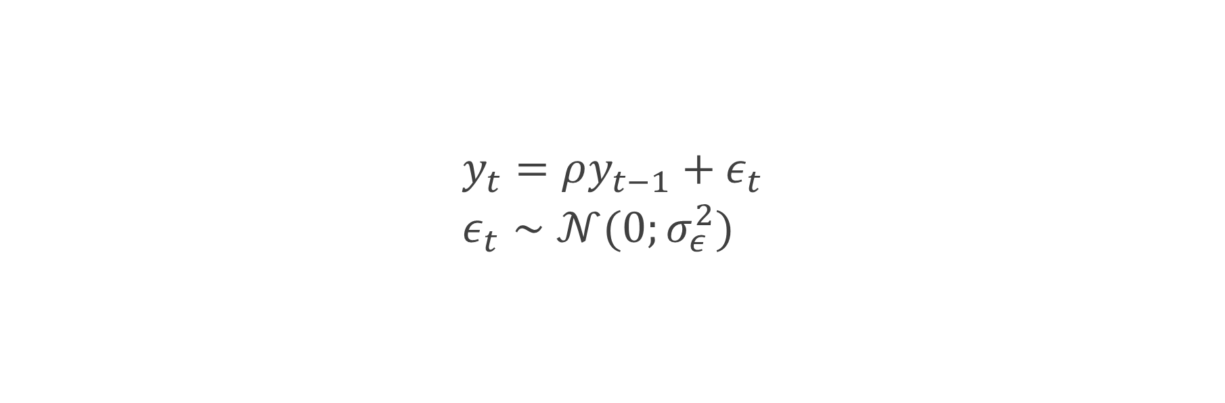
AR(1) When yesterday still matters today
$$y_{t}=ρy_{t−1}+ε_{t} \\ ε_{t}∼𝒩(0;σ_{ε}^{2})$$

Slide 20
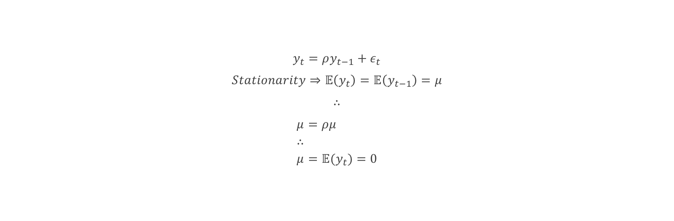
AR(1) conditions for stationarity – constant Mean
$$y_{t}=ρy_{t−1}+ε_{t}$$
$$Stationarity⇒𝔼\left(y_{t}\right)=𝔼\left(y_{t−1}\right)=μ$$
$$∴$$
$$μ=ρμ \\ ∴ \\ μ=𝔼(y_{t})=0$$

Slide 21
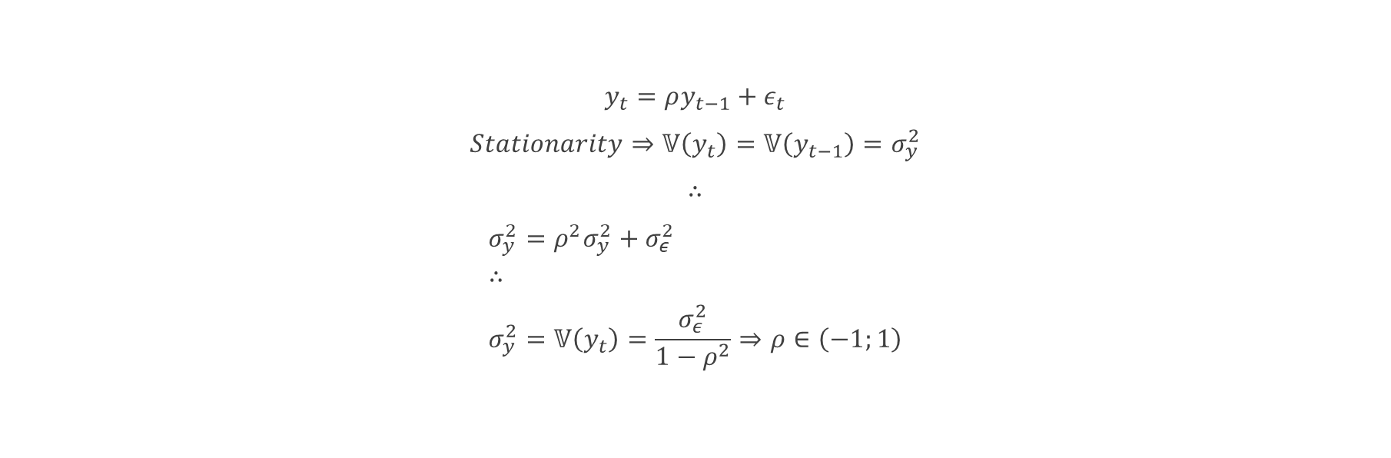
AR(1) conditions for stationarity – constant variance
$$y_{t}=ρy_{t−1}+ε_{t}$$
$$Stationarity⇒𝕍\left(y_{t}\right)=𝕍\left(y_{t−1}\right)=σ_{y}^{2}$$
$$∴$$
$$σ_{y}^{2}=ρ^{2}σ_{y}^{2}+σ_{ε}^{2} \\ ∴ \\ σ_{y}^{2}=𝕍\left(y_{t}\right)=\frac{σ_{ε}^{2}}{1−ρ^{2}}⇒ρ∈\left(−1;1\right)$$

Slide 22
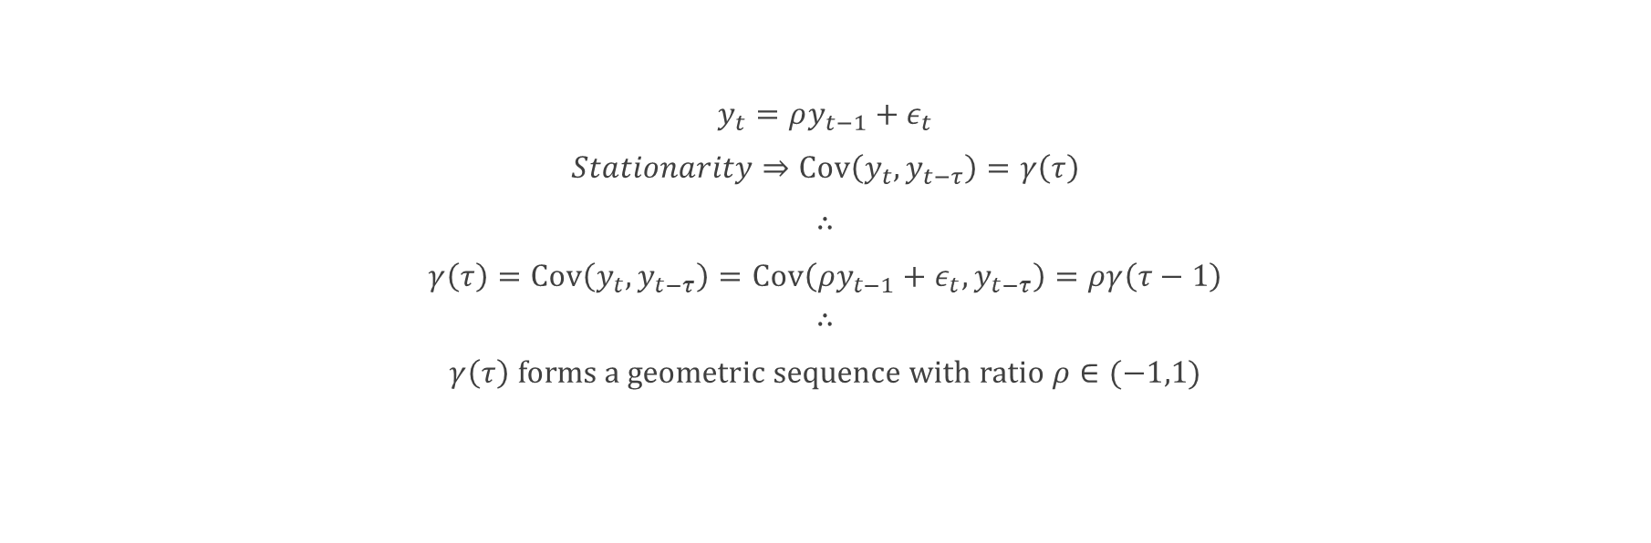
AR(1) conditions for stationarity – constant covariance
$$y_{t}=ρy_{t−1}+ε_{t}$$
$$Stationarity⇒Cov\left(y_{t},y_{t−τ}\right)=γ\left(τ\right)$$
$$∴$$
$$γ\left(τ\right)=Cov\left(y_{t},y_{t−τ}\right)=Cov\left({ρy}_{t−1}+ε_{t},y_{t−τ}\right)=ργ\left(τ−1\right)$$
$$∴$$
$$γ\left(τ\right) forms a geometric sequence with ratio ρ∈(−1,1)$$

Slide 23
Moving average models
When shocks dissipate slowly over time

Slide 24
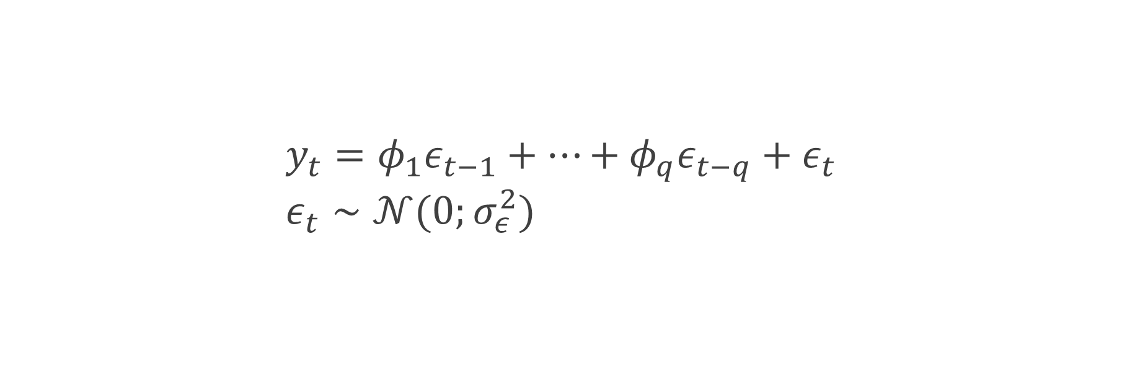
MA(q) When shocks in the q previous days still matter today
$$y_{t}=φ_{1}ε_{t−1}+…+φ_{q}ε_{t−q}+ε_{t} \\ ε_{t}∼𝒩(0;σ_{ε}^{2})$$

Slide 25

MA(q) with covariates When shocks in the q previous days still matter today
$$y_{t}=β_{0}+φ_{1}ε_{t−1}+…+φ_{q}ε_{t−q}+β_{1}X_{1t}+…+β_{k}X_{kt}+ε_{t} \\ ε_{t}∼𝒩(0;σ_{ε}^{2})$$

Slide 26
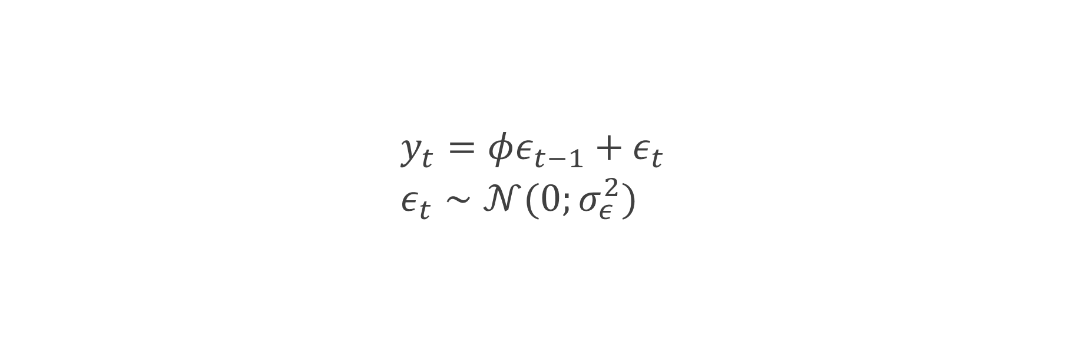
MA(1) When shocks yesterday still matter today
$$y_{t}=φε_{t−1}+ε_{t} \\ ε_{t}∼𝒩(0;σ_{ε}^{2})$$

Slide 27
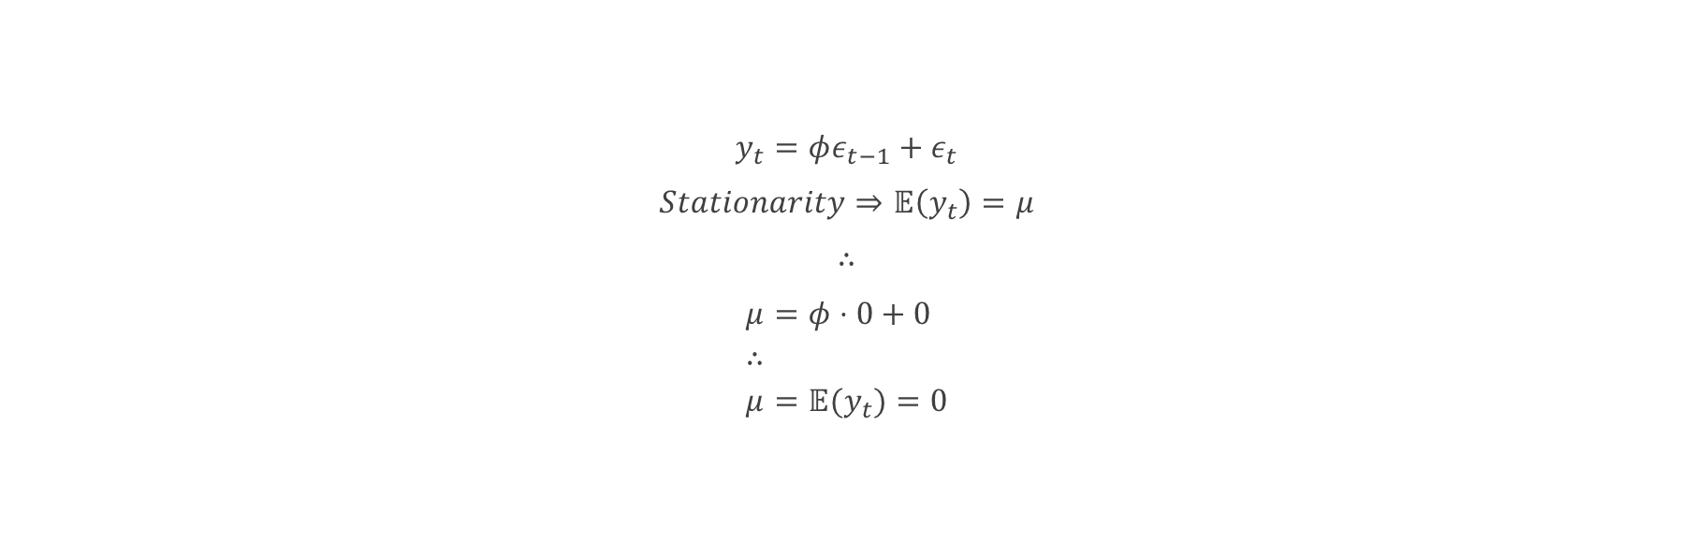
MA(1) conditions for stationarity – constant Mean
$$y_{t}=φε_{t−1}+ε_{t}$$
$$Stationarity⇒𝔼\left(y_{t}\right)=μ$$
$$∴$$
$$μ=φ⋅0+0 \\ ∴ \\ μ=𝔼(y_{t})=0$$

Slide 28
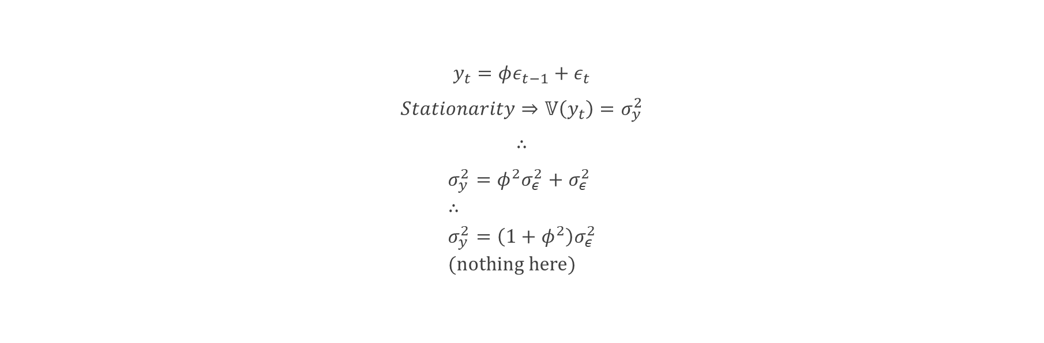
MA(1) conditions for stationarity – constant variance
$$y_{t}=φε_{t−1}+ε_{t}$$
$$Stationarity⇒𝕍\left(y_{t}\right)=σ_{y}^{2}$$
$$∴$$
$$σ_{y}^{2}=φ^{2}σ_{ε}^{2}+σ_{ε}^{2} \\ ∴ \\ σ_{y}^{2}=\left(1+φ^{2}\right)σ_{ε}^{2} \\ (nothing here)$$

Slide 29
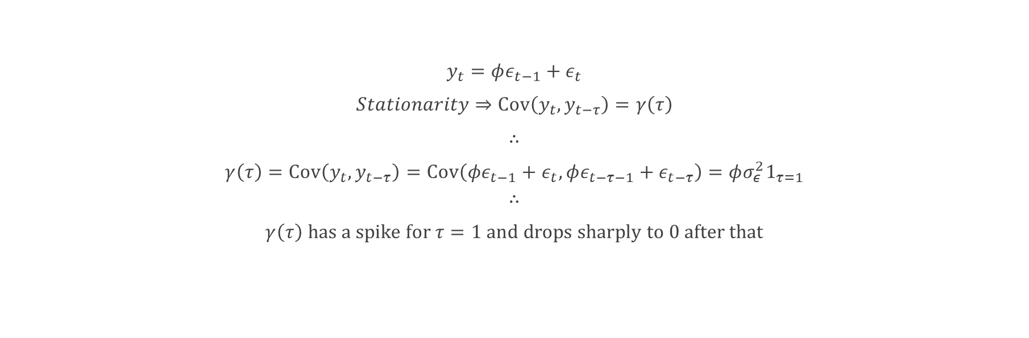
MA(1) conditions for stationarity – constant covariance
$$y_{t}=φε_{t−1}+ε_{t}$$
$$Stationarity⇒Cov\left(y_{t},y_{t−τ}\right)=γ\left(τ\right)$$
$$∴$$
$$γ\left(τ\right)=Cov\left(y_{t},y_{t−τ}\right)=Cov\left({φε}_{t−1}+ε_{t},φε_{t−τ−1}+ε_{t−τ}\right)=φσ_{ε}^{2}1_{τ=1}$$
$$∴$$
$$γ\left(τ\right) has a spike for τ=1 and drops sharply to 0 after that$$

Slide 30
Autoregressive Moving average models And its integrated version
The best of both worlds

Slide 31
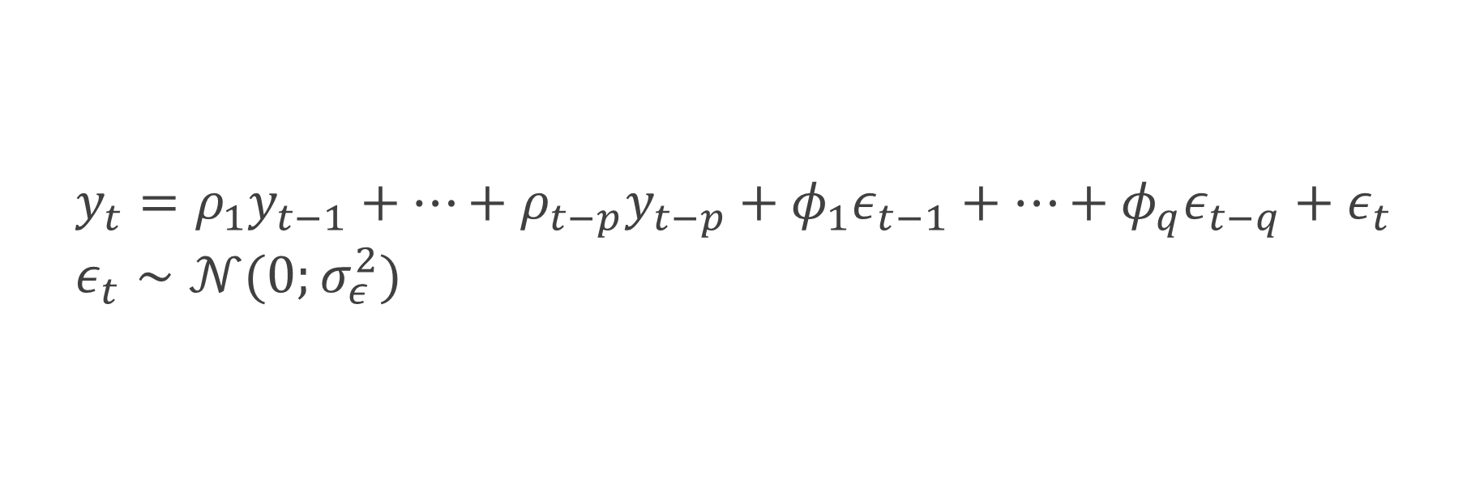
arMA(p,q) AR(P) + MA(Q)
$$y_{t}=ρ_{1}y_{t−1}+…+ρ_{t−p}y_{t−p}+φ_{1}ε_{t−1}+…+φ_{q}ε_{t−q}+ε_{t} \\ ε_{t}∼𝒩(0;σ_{ε}^{2})$$

Slide 32
arIMA(p,d,q)
A time series that needs to be differentiated D times to become an ARMA(P,Q)
(why is this series called “integrated”?)

Slide 33
arIMA(p,d,q)
Why would we possibly need to differentiate a series?
Pros and cons of differentiation
Random Walk example
Unit Roots and how to test for it
Dickey-Fuller
Augmented Dickey-Fuller
Ng-Perron
…

Slide 34
Box-Jenkins methodology
A visual guide to identifying if a series if AR(P), MA(Q) or ARMA(P,q)

Slide 35
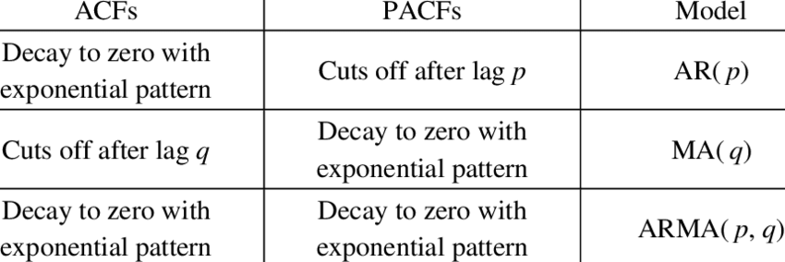

Slide 36
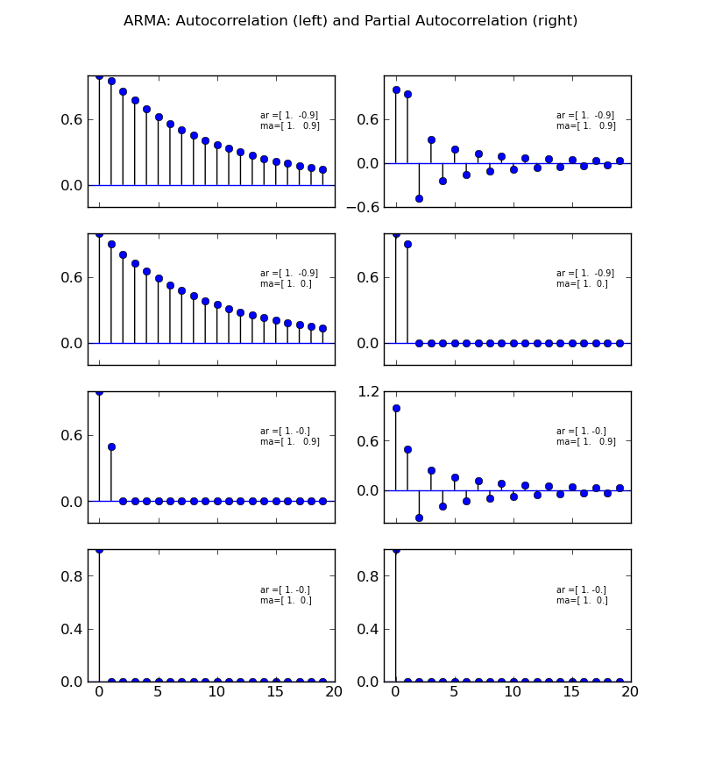
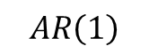
$$AR\left(1\right)$$

Slide 37
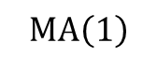
$$MA\left(1\right)$$

Slide 38
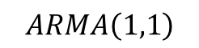
$$ARMA\left(1,1\right)$$

Slide 39
Scattered comments
Holt-Winters
Unit Roots
Augmented Dickey-Fuller
Ng-Perron
Heteroskedasticity
ARCH, GARCH and the family

